Slide 1
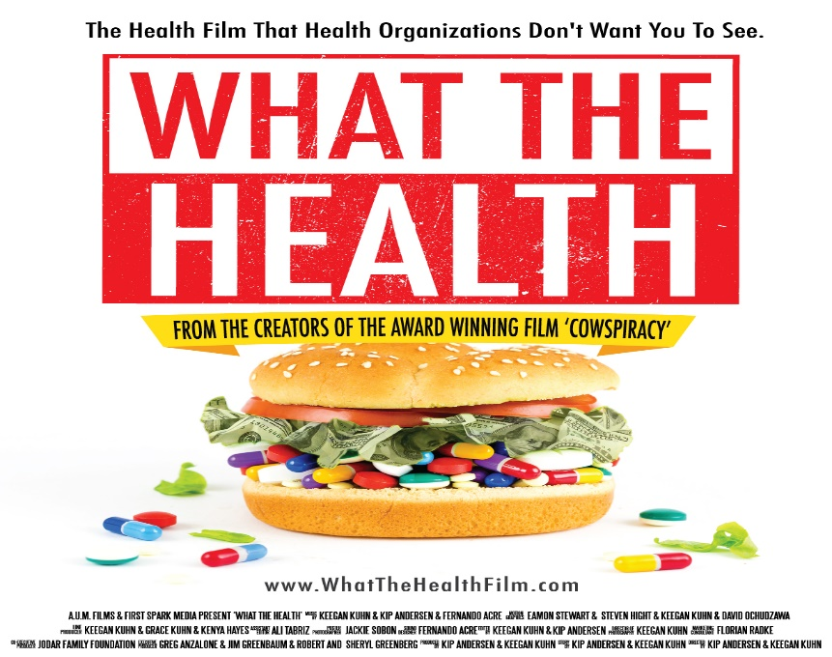
DOCUMENTARY ANALYSIS
“What the Health” Film by Kip Anderson
Notes:
Hello, welcome to my presentation on “what the health” documentary.

Slide 2
Introduction.
Its script was written, produced, and directed by Kip Anderson and was funded through an Indiegogo campaign in 2016.
It includes interviews of physicians and other people related to diet and health by seeking their professional opinions on the different nutritional health issues.
It exposes the misinformation in nutrition that has contributed to the rise of cancer and other diet-related diseases.
With rising cases of diseases related to health, the film blames t the various organizations responsible for providing different health services in the country.
Notes:
The film focuses on addressing the issues related to nutritional health and diet-related disease in America. It criticizes major organizations responsible for matters to do with non-communicable diseases through the hoarding of important information. The film was produced, directed, and also written by Kip Anderson. It exposes the factors contributing to the spread of diabetes and cancer through diet.

Slide 3
Themes.
Describe the consequences of meat consumption, dairy products, and eggs by individuals who did not have information on nutritional health.
Encourages consumption of a diet based on organic plants as the alternative to the carcinogen products.
It highlights how misguiding nutritional health information has been used by leading companies to increase their sales at the expense of public health.
The film aims at informing the network of a conspiracy between meat, dairy, and industries dealing with pharmaceuticals with health organizations in the US for financial benefits.
Encourages individuals to take charge of their own body through physical health and a balanced diet.
Notes:
The film highlights different points relating to nutritional health and diet and how dairy products, eggs, and meat contribute to the diagnosis of health problems, especially diabetes and cancer, in the place of the unhealthy animal products, the fil proposals consumption of organic plants. Through relevant interviews, the film highlights misguiding information about the above products for marketing purposes by firms and leading the meat and dairy industries.

Slide 4
Techniques used to persuade in the film.
Interviews were conducted between the producer and physicians who have provided their professional opinion about different principles and issues of nutritional health.
Use of case studies of individuals who have taken up a vegan diet and their health experience was transformed; this appeals to individuals to consider changing their diet.
Presentation of data and research results which indicates the products consumed and yet classified as carcinogens. This makes people convinced of products that cause health problems and therefore avoid them,
Use of images and pictures of individuals who have had diet-related diseases and how they applied the vegan diet to recover from the conditions.
Notes:
The film applies different techniques to persuade the audience to reflect and practice the ideas which they propose. To appeal to the audience, there is the use of interviews with physicians and other professionals who would provide their opinion on the issues of a healthy diet. Facts on different researches and data have been provided to make their analysis logically. Images, pictures, and videos have been used by individuals who have survived diet-related issues by changing their diet.

Slide 5
Criticism of the film.
The film is biased in its presentation of a solution to the nutrition health issues as it only recommends veganism; this shows they had a predetermined agenda.
Different physicians consider film propaganda since it overstated the effects of meat, dairy products, and eggs without highlighting their positive impact.
The film does not consider the impact of poor farming methods on the veganism being proposed, which are also health risks.
The film is not backed up using scientific proof to their allegations about the foods they are discouraging.
Notes:
Different reviews have been made about the film and have faced a lot of criticism from physicians and other professionals. The film seems to have a predetermined agenda as it only proposes veganism as the only solution to nutritional health issues. The film is propaganda as it is focused on discrediting dairy products, eggs, and meat while presenting veganism as the cure to all the health problems. Due to biasness, it does not explain the positive effects of the products they discredit and the impact of poor farming methods on veganism and health. The film is not backed up scientifically.

Slide 6

conclusion.
The film is biased, and therefore it would be recommended for entertainment purposes only.
The film presents good skills for persuasion and should be recommended as effective journalism.
While this film presents real health issues caused by the consumption of junky food, it does not present scientific evidence on why it recommends veganism as the solution.
The film is accurate in its proposal on human beings taking control and regulation of their body by controlling their diet and exercising.
Notes:
The film is presented and produced in a biased manner and therefore ignores important facts and that otherwise would have shaped the logic of the film. The producer and presenter portray some level of professional journalism and the use of persuasion skills. The film would be recommended to encourage people to take charge of their bodies by regulating diet and physical exercises.

Slide 7
References.
https://d35a0majfjch7v.cloudfront.net/wp-content/uploads/2018/11/FeaturedImage_Major-Claims-What-the-Health-1-1200x675.jpg
https://m.media-amazon.com/images/M/MV5BYWU3ZTk1ZDgtNTFlOC00MGRjLWFiZmQtYmI0Y2JjMmI5YTBkXkEyXkFqcGdeQXVyNzI5MjI4MTc@._V1_.jpg
https://www.youtube.com/watch?v=X1QDkpUPiI8&t=88s

